Slide 1
Other People Matter Mindset

Slide 2
Understand

Slide 3
What is The Positivity Project?
The mission of The Positivity Project is to empower YOU to build strong relationships -- and to understand, appreciate, and exemplify the character strengths in us all.

Slide 4
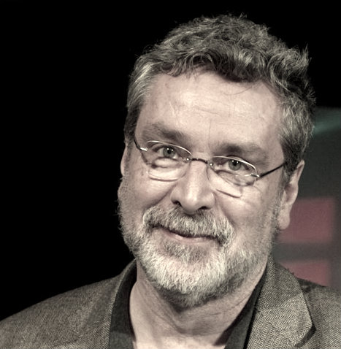
What is positive psychology?
“I can sum up positive psychology in just three words – Other People Matter. Period. Anything that builds relationships between and among people is going to make you happy.” - Dr. Chris Peterson (1950-2012)

Slide 5
What Does “Other People Matter” Mean?
Notes:
Video Link: https://www.youtube.com/watch?v=AEc2W8JVuRw

Slide 6
Why are relationships so important?
Turn to the person next to you and answer the following questions:
Why do you think Dr. Peterson mentions relationships as a core aspect of positive psychology?
How have you seen people build strong relationships?
What would it look like to live with the mindset that “Other People Matter”?
Now, share your thoughts with the classroom.

Slide 7
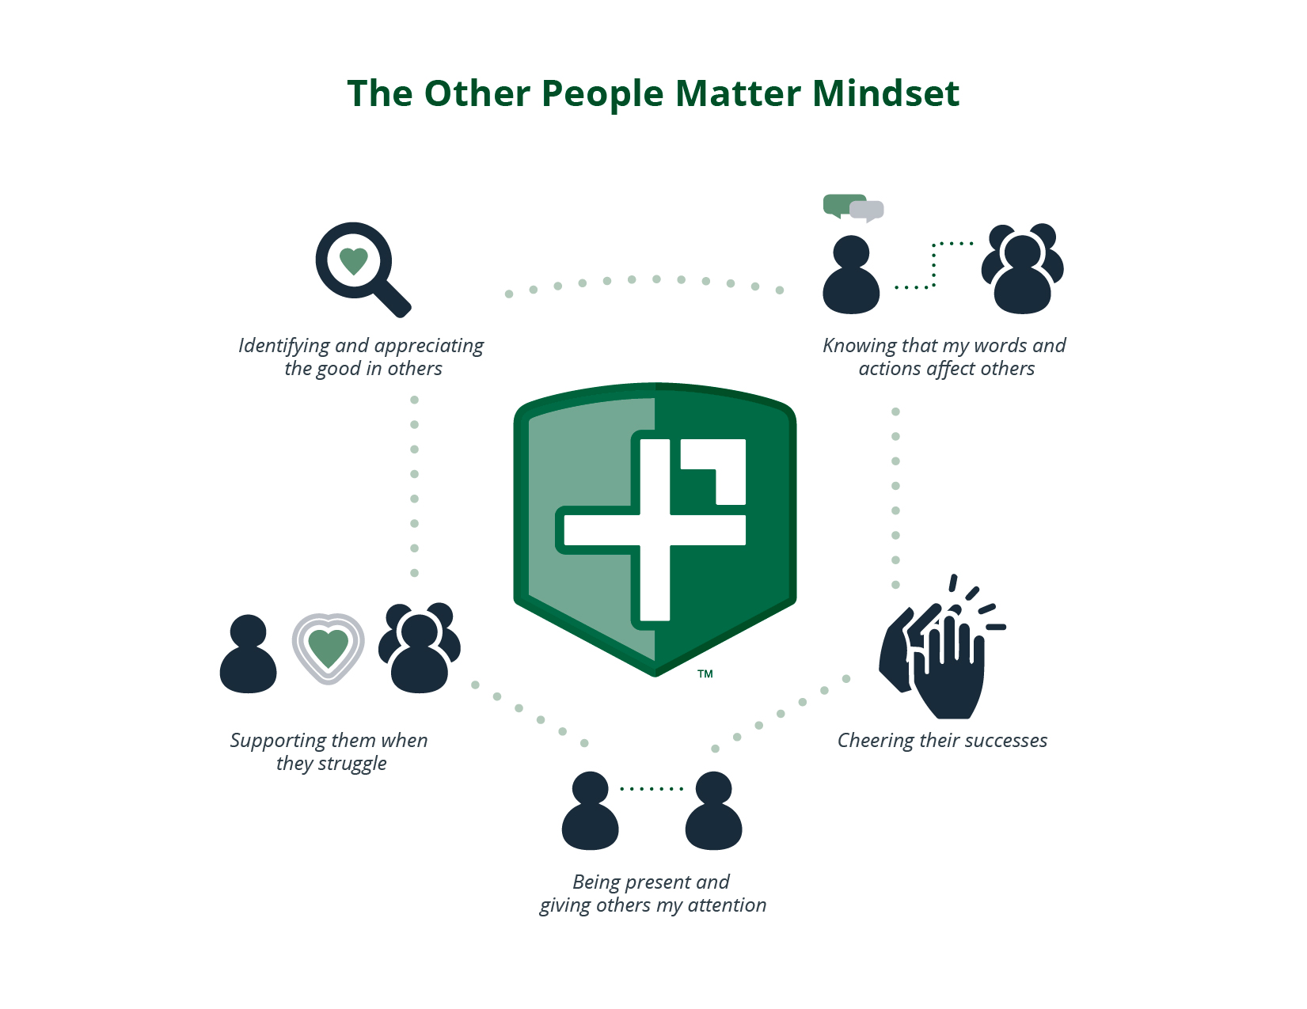
Other People Matter Mindset
Notes:
This is what it looks like for an individual to live with the mindset that Other People Matter. Following these practices, combined with understanding, appreciating, and exemplifying the character strengths in us all, will help individuals build strong relationships.

Slide 8
Harvard Study of Adult Development
A nearly 80-year Harvard study tracked 724 men across their lifespans to understand what mattered to a good life.
The study began in the 1930s with two groups: Harvard sophomores and teens from Boston’s poorest neighborhoods.
Research is ongoing with blood draws, brain scans, and interviews with spouses & children.

Slide 9
Harvard Study synopsis - 3-minute video
Notes:
Link to video here: https://drive.google.com/file/d/0B7uPo8G9U6FdN21xX0FDN1VrRFk/view?usp=sharing

Slide 10
Character and You
When you think of the word “character”, what words come to mind?
Do you think character is one thing or multiple things?
If you had to create a dictionary definition for the word character, how would you define it?
Take a moment to think and then share your thoughts with the class.

Slide 11
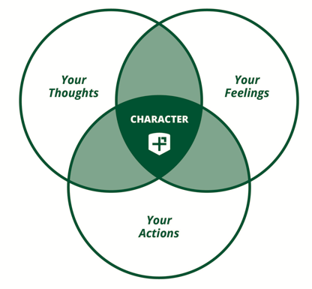
What is Character?
Definition: A family of thoughts, feelings, and actions that are recognized and encouraged across cultures for the values they cultivate in people and society.
Your character is complex. It is the combination of your thoughts, your feelings, and your actions.
Simply stated, your character is who you are.

Slide 12
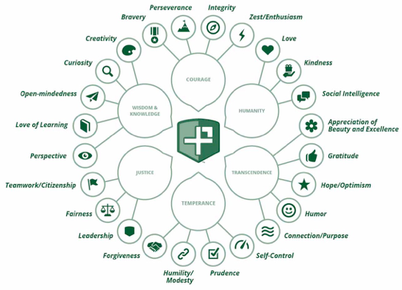
The 24 Character Strengths
Notes:
The 24 character strengths are the outer edge of this circle. They are groups into six buckets that are called virtues. These strengths were determined following extensive research.

Slide 13
What are the 24 character strengths?
Dr. Chris Peterson took a three-year sabbatical from teaching to better understand character, before co-authoring an 800-page book on his findings.
He discovered:
24 character strengths that are evident in the most widely influential traditions of thought in human history.
Robust evidence of ALL 24 strengths existing throughout time and in all cultures of the world.
All 24 character strengths exist in every individual.

Slide 14
Video on the 24 Character Strengths
Notes:
https://www.youtube.com/watch?v=TtsAn84Si9g

Slide 15
Engage

Slide 16
Activity: Other People Matter Flip Book
Turn to a person next to you and discuss the following questions:
Where have you seen any of the five elements of the Other People Matter Mindset in your life?
Where have you seen their opposites? (e.g. looking for the faults of others, hoping they fail, checking your phone instead of listening)
What were the results of those interactions? How did they help or hurt relationships?
Now, create a flip book that exemplifies each element. Include practical examples you could implement in your life.

Slide 17
Activity: Blind Retriever
Step 1: There are eight objects hidden in the room, it’s your team’s job to find them.
Step 2: Break up into 3-4 person teams
Step 3: One person is blindfolded in each team and directed by their teammates using simple commands to try and find the object before the other team.
Step 4: Compete against each other to try and retrieve as many objects as possible.
Step 5: After the activity is complete, discuss which elements of the Other People Matter Mindset your team used.

Slide 18
Activity: Human Knot
Step 1: Break into groups of 7-12 people. Have everyone stand in a circle facing each other, shoulder to shoulder.
Step 2: Instruct everyone to put their right hand out and grab a random hand of someone across from them.
Step 3: Then, tell them to put their left hand out and grab another random hand from a different person across the circle.
Step 4: Within a set time limit, the group needs to untangle the knot of arms without releasing their hands. You are competing against the other groups in the class.
Step 5: After the activity is complete, discuss which elements of the Other People Matter Mindset your team used.
(Note: If the groups are too large, make multiple smaller circles)

Slide 19
Reflect

Slide 20
Other People Matter Mindset

Slide 21
Your Relationships
Get out something to write on. Take the next 5 minutes to answer the following questions:
What are the three most important relationships in your life?
Why are they so important?
What are you doing to make them strong?
What are some actionable steps (from the OPM Mindset or otherwise) you can take to make them stronger?
Next, take 5 minutes as a class to discuss the elements of a strong relationship -- and how you can strengthen your relationships.

Slide 22
Character and Relationships
Look at the next slide and discuss the following questions as a class:
In your close relationships, what is more important to you...Who the person is or whether the person is famous, or wealthy, or achieved at a high level?
How do you want people to value you? Your internal character -- or your external achievements, money, or popularity?
Have you seen relationships based on extrinsic factors? How have you seen those relationships play out over time?

Slide 23
Who you are > What you are
Notes:
Positivity Project Partner Schools embrace that an individual’s character is more important than social media likes, the kind of clothes a person wears, or their test scores.

