Slide 1
Perspective

Slide 2
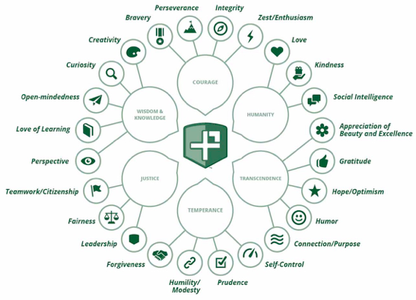
The 24 Character Strengths

Slide 3
Understand

Slide 4
Perspective
What does perspective mean to you?

Slide 5
Curiosity
You are curious about everything.
You are always asking questions, and you find all subjects and topics interesting.
You like exploration and discovery.

Slide 6
I’ve learned that two people can look at the exact same thing and see something totally different.

Slide 7
Apple - Perspective Video
Notes:
Video Link: https://www.youtube.com/watch?v=TJ1SDXbij8Y

Slide 8
Talk with a Neighbor
How do you think this video demonstrated perspective?
Why is it important to look at different perspectives?
Think back to what we learned about open-mindedness. How are open-mindedness and perspective related?

Slide 9
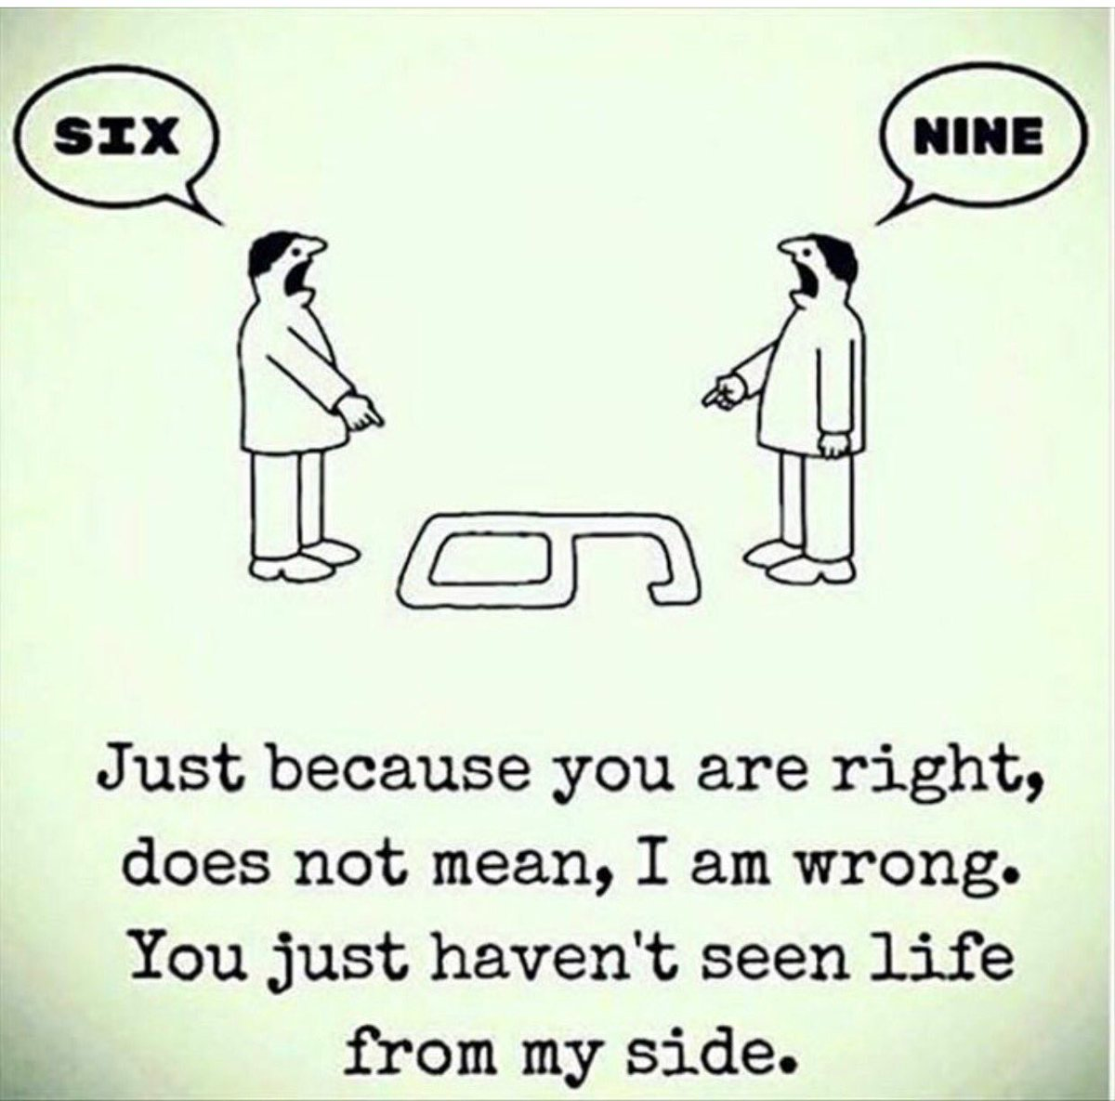
Discuss in terms of PERSPECTIVE:

Slide 10
Everything we hear is an opinion, not a fact. Everything we see is a perspective, not the truth.
Marcus Aurelius

Slide 11
If we could see inside others’ hearts - Video
Notes:
Video Link: https://www.youtube.com/watch?v=Wl2_knlv_xw

Slide 12
Discussion Questions
What did you learn from this video?
Why is it important to keep perspective in mind?

Slide 13
You only understand people if you see them in yourself.
John Steinbeck

Slide 14
Empathy - A Short Film
Notes:
https://www.youtube.com/watch?v=FXezI2l_0nM

Slide 15
Discussion Questions
What did you learn from this video?
How can taking another’s perspective make a positive impact on their life?
The main character in this short film also practiced kindness. Do you think kindness is enhanced by using the character strength of perspective -- and putting yourself in someone else’s shoes?

Slide 16
Oprah on Legacy and Advice
Notes:
https://youtu.be/3EYK0C8-A68

Slide 17
Discussion Questions
Oprah Winfrey has interviewed thousands of people and is one of the most famous talk show hosts of all time.
Do you think she is able to see the world through the eyes of others?
How do you think her ability to see others’ perspective helps her as a talk show host?
How do you think it helps her give advice?

Slide 18
Kevin Spacey - Acting and Empathy
Notes:
https://www.youtube.com/watch?v=i-HRhQKwaCQ

Slide 19
Discussion Questions
Do you think perspective is important in his job as an actor?
Do you think perspective can help people make better decisions?
How do you use perspective in your own life?

Slide 20
When you look at a field of dandelions, you can either see a hundred weeds or a hundred wishes…

Slide 21
Engage

Slide 22
Your Perspective
In your own words, what is perspective?
Where does perspective rank on your character strengths?
How do you think you use perspective in your everyday life?

Slide 23
Curiosity
You are curious about everything.
You are always asking questions, and you find all subjects and topics interesting.
You like exploration and discovery.

Slide 24
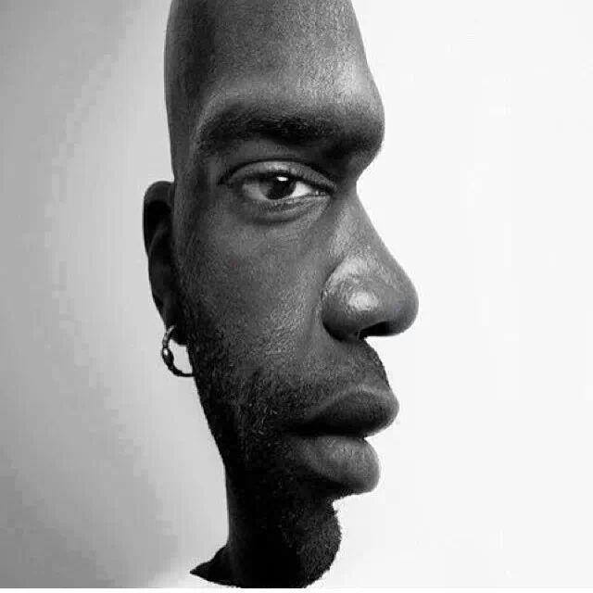
Perspective Images Activity
Is this someone staring towards you or facing right?

Slide 25
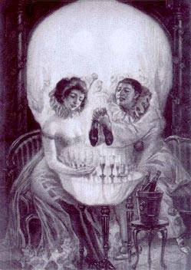
Perspective Images Activity
What do you see first, a couple or a skull?

Slide 26
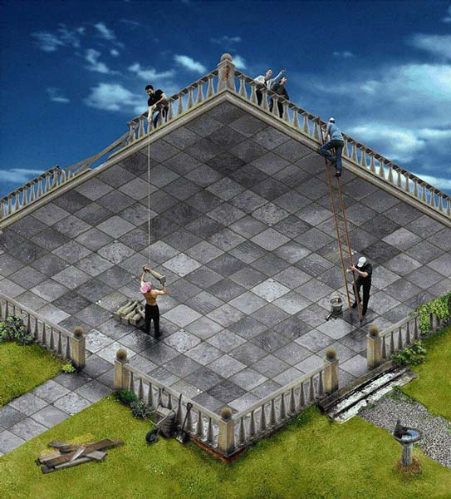
Perspective Images Activity
Are you looking at the top or bottom of this terrace?

Slide 27
Perspective Images Activity
What do you see first, a duck or a bunny?

Slide 28
Perspective Images Activity
Can you see the dragon, the face, and the box?

Slide 29
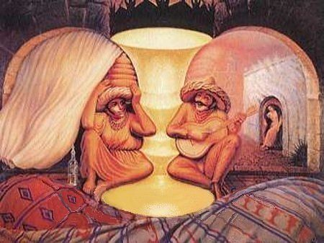
Perspective Images Activity
Can you see two old lovers, two musicians, and the vase?

Slide 30
Follow Up Questions
Were you able to see all perspectives immediately?
Which was easiest or the most difficult?
What did you learn from this activity regarding perspective?

Slide 31
Timeless Activity
If you could be any age, what would you be and why?
Answer this question for yourself and then talk with a partner about this.

Slide 32
Timeless Activity
Notes:
Video Link: https://www.youtube.com/watch?v=Oeu_bgSczLY

Slide 33
Timeless Activity
What do you like about being your age now?
Answer this question for yourself and then talk with a partner about this.

Slide 34
Follow Up Questions
What patterns did you notice about current age and age they wanted to be?
What did this activity show you about perspective?

Slide 35
Richie Rich Video
Notes:
Video Link: https://www.youtube.com/watch?v=VazRhsh6uys

Slide 36
Richie Rich Discussion
What do you think is going on in this scene?
Why does Richie want to play baseball with the other kids?
Why do the other kids not want to include Richie?
What examples from the clip show misunderstandings due to different perspectives?

Slide 37
Richie Rich Activity
Think of a time where you felt left out, misunderstood, or like everyone was against you.
Talk about it with a partner and see if you can try to explain the situation from the other point of view!

Slide 38
Reflect

Slide 39
Perspective - Wrap Up
Next time you feel as though you’re being misunderstood or not quite seeing eye to eye with someone, what can you do to see things from a different perspective?
Why is it important to think about different perspectives?
How can a different viewpoint help you in your everyday life?

Slide 40
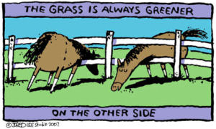
How does this picture show what you’ve learned about perspective?

