Slide 1
Teamwork/
Citizenship

Slide 2
Understand

Slide 3
Teamwork/
Citizenship
What do teamwork and citizenship mean to you?
Understand

Slide 4
Fairness
Fairness means to…
Play by the rules
Take turns and share
Be open-minded; listen to others
Don’t take advantage of others
Don’t blame others carelessly
Treat all people fairly

Slide 5
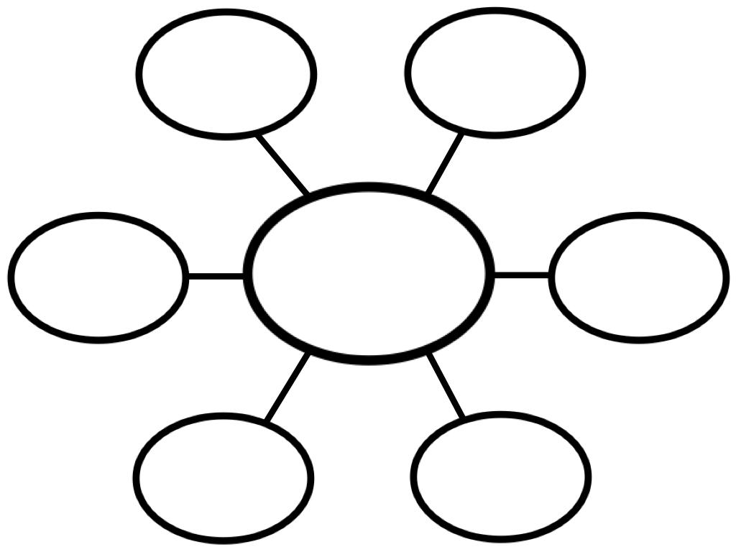
Brainstorm with a Group
Identify the most essential components of a team by creating an idea web.
Identify important characteristics of a citizen by creating an idea web.
Understand

Slide 6
LeBron James
Notes:
https://www.youtube.com/watch?v=SFpnrOKq5_0

Slide 7
Discussion Questions
David Griffin acknowledged James’s dedication to his team, “He is a guy whose greatness is in his ability to bring about other’s greatness.” How can someone be both a leader and a team player?
LeBron James remarked, “Sacrifice yourself and what you can do for the betterment of the team.” How might being a team player involve sacrifice?

Slide 8
Motivation to Become a Team
Notes:
https://www.youtube.com/watch?v=StIBPiMQQ28

Slide 9
Discussion Questions
What obstacles did the Titans have to overcome to unify as a team?
What obstacles must your class overcome to become unified as a team?
What common goal are you working toward as a class?
What steps did the Titans have to take to become a team?
What steps have you had to take in your life to become a team member?
Besides sports, what other areas of life require teamwork?

Slide 10
Alone we can do so little. Together we can do so much.
Helen Keller

Slide 11
Engage

Slide 12
Minefield Challenge!
Use desks, chairs, water bottles, etc. to create an obstacle course of “mines” within your space. Everyone must have a partner. One partner must keep his/her eyes closed, and the other must guide that person from one end of the course to another without setting off any mines. The person guiding their partner cannot enter the course and must only use verbal instructions to get their partner through the obstacles.
Notes:
Depending on the number of people you have and how difficult you want this activity to be, you can vary the number of pairs trying to complete the course at the same time so that pairs have to work harder to listen to each other and communicate clearly.

Slide 13
Minefield Challenge Reflection
What did you find most difficult about this challenge?
What were the keys to success in this challenge?
What components of teamwork in this challenge did you have to use to succeed?

Slide 14
Ultimate Tower Challenge
Find a group of 4 or 5. In each group, you will have to appoint a runner, recorder, architect, and carpenter(s).
The runner is to pick up the 3 pieces of scrap paper from the teacher.
The architect is to supervise the building of a structure using the playing cards.
The carpenters are to build the structure.
The recorder is to write down comments, progress, disagreements, etc., while the structure is being built. When the structure is done or time is up, the runner will present the recorder’s findings.

Slide 15
Ultimate Tower Challenge
You have 5 minutes to create the tallest paper tower using only 3 sheets of scrap paper. Each group member must complete his/her role.

Slide 16
Tower Challenge: Reflection
Recorders, what did you write down?
What attitudes and behaviors were helpful in your attempts to build the tower?
What attitudes and behaviors did you encounter that made your group less successful in working together?
Using your experiences, create five guidelines for successful teamwork in a cooperative setting.

Slide 17
Citizenship in the Classroom
What does it mean to be a good citizen in the classroom? (Record all answers on the board.)
What are the top 5 best answers from the previous question? (Discuss as a class and vote.)
How can each of these top 5 answers be demonstrated in the classroom?

Slide 18
Classroom Citizen Rubric
Create a classroom citizen rubric using your top 5 responses and at least 3 different ways each of them can be observed.
1. | 2. | 3. | 4. | 5.
1. | 1. | 1. | 1. | 1.
2. | 2. | 2. | 2. | 2.
3. | 3. | 3. | 3. | 3.

Slide 19
Classroom Citizenship Rubric Reflection
Once the chart has been completed, rate yourself in each category on a scale of 1-5. Partner with one peer to reflect on your chart together using the questions below.
In what areas are you the strongest?
In what areas are you the weakest?
How can you improve your weakest areas?

Slide 20
Good Citizen Award
Who would you choose in your class to receive the good citizen award? Create a good citizen award certificate to give to him/her.
Include the following:
name of award
his/her name
why he/she deserves it
today’s date
your signature

Slide 21
We may have all come on different ships, but we're all in the same boat now.
Dr. Martin Luther King Jr.

Slide 22
Reflect

Slide 23
Citizenship is the chance to make a difference to the place where you belong.
Charles Handy

Slide 24
Create a Citizenship Chain!
Create your own citizenship/teamwork quote using what you learned this week and write it on a strip of paper. Connect the links to create a citizenship chain to display as a reminder in our classroom!

