Slide 1
Creativity

Slide 2
Understand

Slide 3
Creativity
What does creativity mean to you?
Understand

Slide 4
Curiosity
You are curious about everything.
You are always asking questions, and you find all subjects and topics interesting.
You like exploration and discovery.

Slide 5
CONNECTION TO ANTI-BULLYING MONTH
Creativity means coming up with new and original ways to do things; it requires open mindedness and courage. How does bullying stop people from expressing their creativity?
Bullying can keep people from sharing their creativity and individuality. Trojans, lets make this a school where every student knows their creativity is valued!

Slide 6
Why Do We Need Creativity?
Notes:
https://www.youtube.com/watch?v=6unnLOsXHxM

Slide 7
Why Do We Need Creativity?
Why do you believe creativity has declined?
Why do you think creativity trumps all and is the most valuable and essential quality according to CEO’s who are looking to hire?
Do you feel that school stunts your creativity?
Brainstorm different ways that teachers could integrate more creative opportunities for you at school.

Slide 8
Engage

Slide 9
The Secret to Creativity
Notes:
https://www.youtube.com/watch?v=X_Y-T_guM1I

Slide 10
The Secret to Creativity
Where does creativity come from?
According to the video, “Creativity is everywhere!” Name 5 places you see creativity everyday.
The video claimed that you can use creativity to solve problems. What problems could you solve using creativity?

Slide 11
The Secret to Creativity Continued...
The video stated that risk taking and open mindedness both contribute to creativity. Can you think of anything else that might contribute to creativity?
According to the video, creativity can be taught. How might you teach someone how to be creative?
“Creativity has a social purpose.” What does this quote from the video mean? How can creativity have a social purpose?

Slide 12
Alternative Use Test
In the video, the alternative use test was given to measure and cultivate the creativity of individuals. This test proves that anyone can be creative, but we must nurture our creativity and let our minds wander.
With a partner, make a list of alternative uses for each object pictured in the following slides. Challenge each other to see how many alternative uses you can brainstorm together. You will have 1 minute per slide to brainstorm. Share out your ideas and see which partnership brainstormed the most.

Slide 13
Alternative Use Test # 1
Tennis Ball

Slide 14
Alternative Use Test # 2
Paperclip

Slide 15
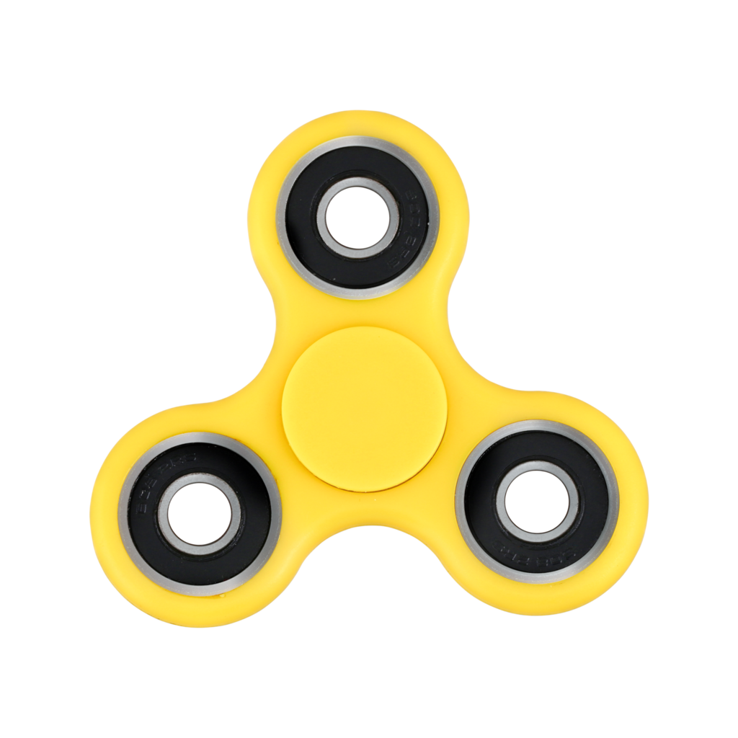
Alternative Use Test # 3
Fidget Spinner

Slide 16
Alternative Use Test # 4
Paint Brush

Slide 17
Alternative Use Test # 5
CD

Slide 18
How to Hack Your Brain to Increase Creativity
Notes:
https://www.youtube.com/watch?v=7M-xwgjI2Tg

Slide 19
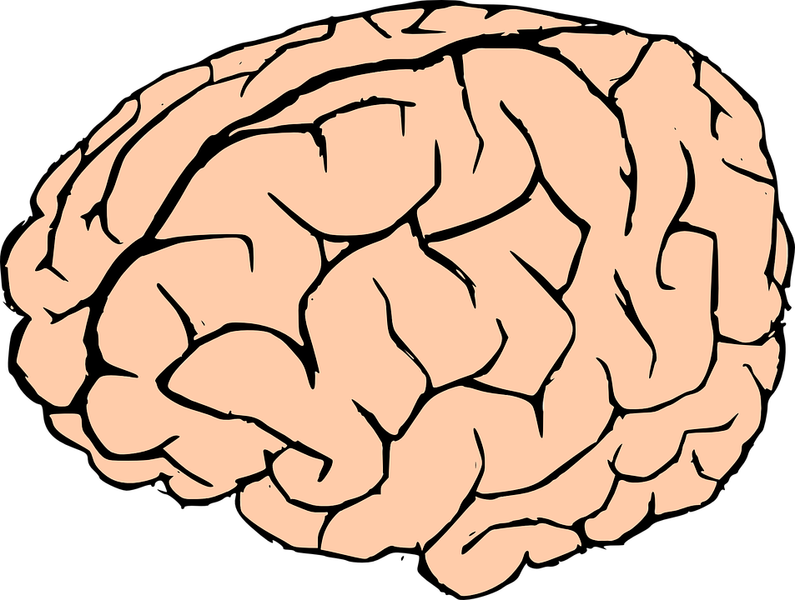
Work with a group to recall all 4 ways that you can hack your brain to increase creativity.

Slide 20
How to Hack Your Brain to Increase Creativity
Were you able to remember all 4 ways that you can hack your brain to increase creativity?
Change the Way You Think
Lift Your Mood
Exercise
Pay Attention to Your Dreams

Slide 21
Let’s get our creative juices flowing with brain hacks # 2 and # 3
(lifting our mood
and exercising)!
Get on your feet and get ready to move!

Slide 22
Let’s Get Our Creative Juices Flowing!
Notes:
https://www.youtube.com/watch?v=CJayD81A2fA&list=PLTOTVP9HmWuS68GKSry80AGSZe6Tl46by&index=2

Slide 23
Creative Prompts Slide 1
Now that your creative juices are flowing, let’s put that creativity into practice. Choose 1 of the following 6 prompts to complete.
Write a story about the zoo without using the names of any animals.
Pretend that you get to make one rule that everyone in the world must follow. What rule do you make? Why?
If people could not see colors, how would traffic lights work? Design a traffic system that does not rely on colors.

Slide 24
Creative Prompts Slide 2
Pretend that parents have to take a test before they can have children. Write six questions that would be on the parenting test.
If you could invent a new subject that would be taught to all children in school, what would the subject be? Why do you think children need to learn about your subject?
If you could choose one thing that costs money and make it free for everyone forever, what thing would you choose? Why?

Slide 25
Share your completed creativity prompt with your group.

Slide 26
Reflect

Slide 27
Who would you nominate as the top 3 most creative people in your class? How do they demonstrate creativity on a regular basis?

Slide 28
Get creative. Choose one way to demonstrate your creativity.
Think outside the box!

