Slide 1
Self-Control

Slide 2
Understand

Slide 3
Self-Control
How would you define self-control?

Slide 4
Fairness
Fairness means to…
Play by the rules
Take turns and share
Be open-minded; listen to others
Don’t take advantage of others
Don’t blame others carelessly
Treat all people fairly

Slide 5
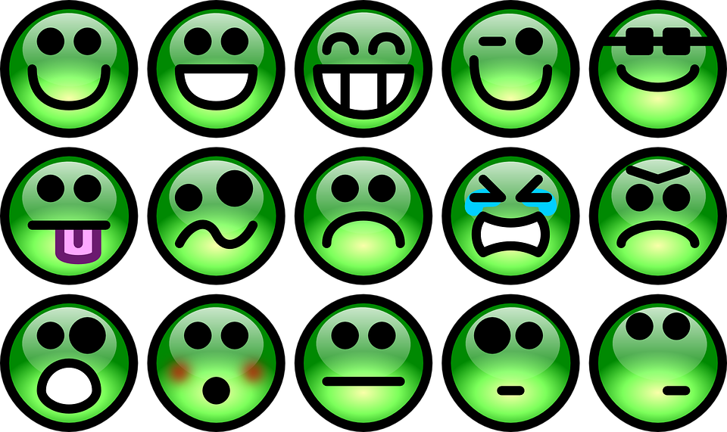
Controlling Your Emotions
What emotions are hardest for you to control?
What emotions are easiest for you to control?

Slide 6
Emotions and the Brain
Notes:
https://www.youtube.com/watch?v=xNY0AAUtH3g

Slide 7
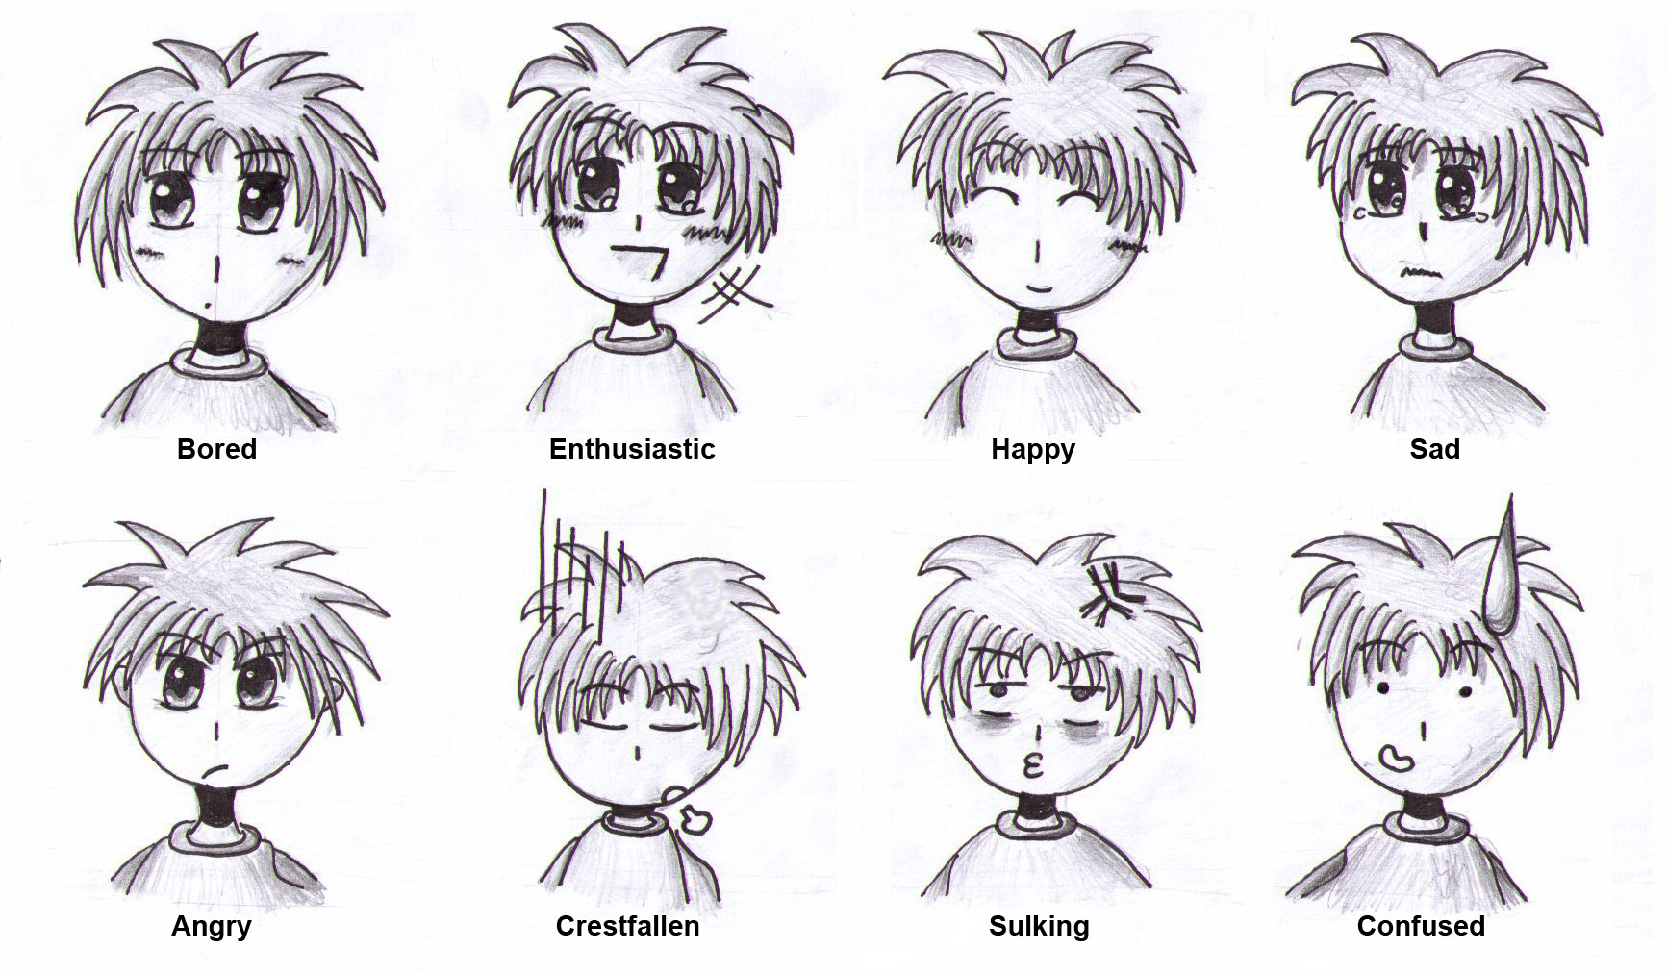
Emotions and the Brain
The video stated, “Emotions can hijack your brain.”
What does this statement mean?
What is a personal example of when your emotions hijacked your brain?

Slide 8
Kevin Lott Speaks
Notes:
https://www.youtube.com/watch?v=5pa5AFx47Uw

Slide 9
Turn and Talk with a Partner
Would you describe yourself as someone who controls your emotions or do your emotions control you?
What situations in the past could you have avoided if you would’ve taken the time to think it through first instead of reacting based on your emotions?

Slide 10
Words of Wisdom from Kevin Lott
“Some people try to make you upset just to get a reaction out of you. Don’t give them that satisfaction.”
“Don’t sweat the small stuff, and it’s all small stuff.”
How could these words of wisdom from Kevin Lott apply to your life?

Slide 11
Willpower and Self-Control
Kelly McGonigal defines willpower as "the ability to do what you really want to do when part of you really doesn’t want to do it."
According to her definition, are willpower and self-control synonymous? Explain your answer.

Slide 12
3 Elements of Willpower
McGonigal believes that willpower consists of three competing elements:
I will – the ability to do what you need to do
I won’t – the other side of self-control; the temptation to not do what you need to do
I want – your true want, the ability to remember the big picture of your life.
With a partner, brainstorm 3 situations in which you can apply these 3 elements of willpower. Apply each of the elements above to each particular situation.

Slide 13
Engage

Slide 14
A World of Self-Control
Imagine a world where everyone practices self-control. With a small group, discuss the following questions:
What problems would be solved?
How might the world be a better place?
How would classrooms differ from today?
How would your family be different?
What careers might be eliminated?
How would your life change?

Slide 15
A World with No Self-Control
Now imagine a world where nobody practices self-control. With a small group, discuss the following questions:
What problems would arise?
How might the world be a more dangerous place?
How would classrooms differ from today?
How would your family be different?
What careers might need more employees?
How would your life change?

Slide 16
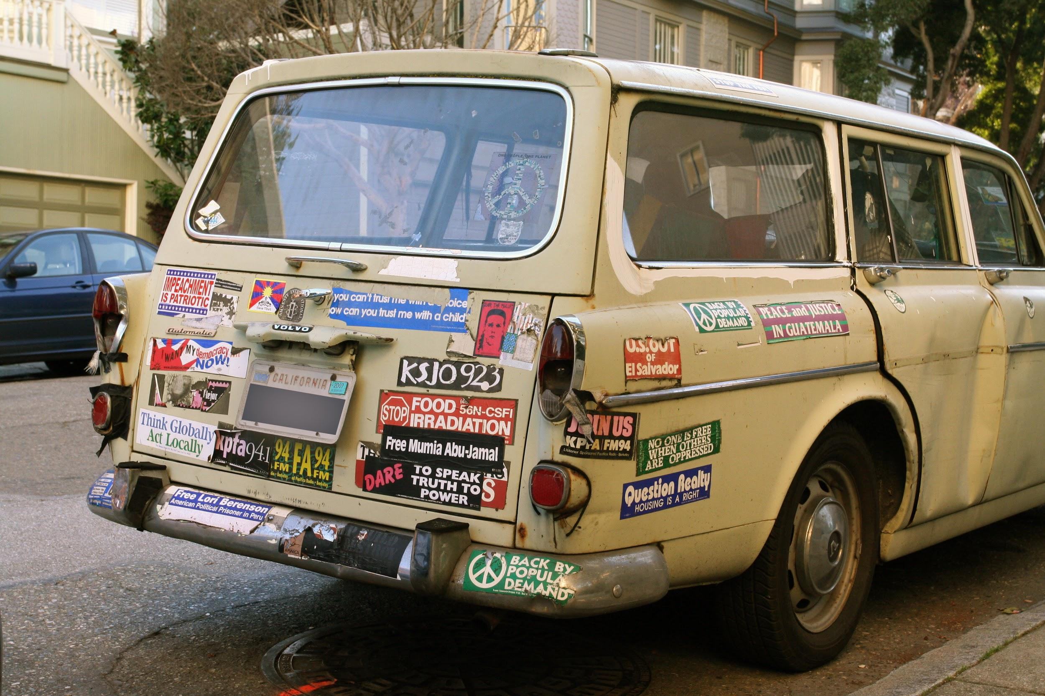
Bumper Sticker
Many people lose control of their temper while driving. Create a bumper sticker that reminds drivers the importance of self-control.

Slide 17
An Analogy of Self-Control
“Feelings are much like waves, we can't stop them from coming but we can choose which one to surf.”
-Jonatan Mårtensson
Create your own analogy that communicates the power of feelings and the choice of self-control.

Slide 18
Drama, Drama
With a group, create and dramatize a real-life application of practicing self-control.
Present dramatizations to the class.

Slide 19
The Marshmallow Test
Click here to watch the marshmallow test.
Why do you think the marshmallow test was an accurate predictor of future success?
Dr. Mischel declared that self-control could be taught. What are some self control strategies that you could implement in your life?

Slide 20
Help Hotline
1-800-SELF-CONTROL
Create questions and/or hypothetical situations that you might call and discuss with a help hotline for those who need guidance practicing self-control. Write the questions or situations on strips of paper and put them in a jar or basket.
Take turns picking from the jar or basket and responding to the situation or question as a help hotline volunteer.

Slide 21
The Stress Factor
What most often makes you stressed?
Are the people/situations that most often stress you out within your power to control or change?
How do you respond to the people/situations that make you stressed?

Slide 22
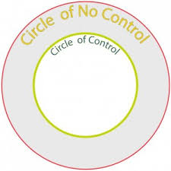
Circle of Control and No Control
These circles represent the two areas where you can focus your time and energy. Many people spend time worrying about things in their Circle of Concern. These represent things in life that we cannot change or things over which we do not have any control. Highly effective people think and act primarily within their Circle of Influence. They forget about the things over which they have no control, preferring to focus their time and energy on issues where they can actually make a difference.

Slide 23
Draw each of these circles on the board and determine together what might belong in each circle.
Examples: Happiness, Chores, Hobbies, Sadness,
Words, Grades, Weather, …

Slide 24
Draw your own set of these circles on a piece of paper and fill them with every choice you have made today. Also, include choices that were not within your control that happened today.
Examples: Late for the Bus, Participated in Class, Ate Breakfast, Studied for My Test, Brought an Umbrella...

Slide 25
Circle of Control Reflection
Which of your circles had the most written inside of it? Did this surprise you?
How should you react if something frustrating happens that is beyond your circle of control?
What if you only worried about what was in your circle of control? How would your life change?

Slide 26
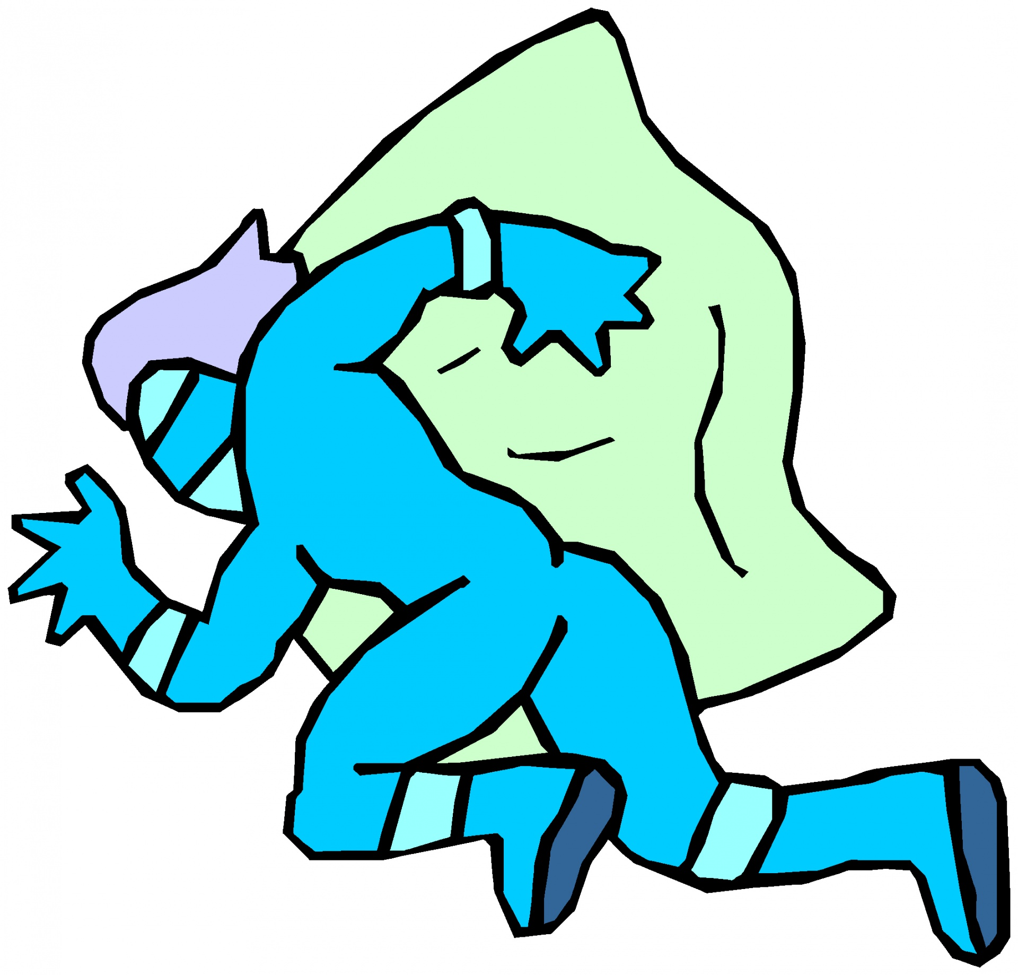
The Arch Enemy of Self-Control
If self-control had an arch enemy, what would it be? Create a comic book character that personifies the Arch Enemy of Self-Control. Illustrate the character and determine what superpowers he/she possess.

Slide 27
Great Debate
“Self-control is solely a matter of thought-control.”
-Napoleon Hill
Based on what you have learned so far about self-control, do you agree with this quote?
Get in 2 groups according to your stance and build your argument. Present your ideas to the opposing side. Practice self-control when it is not your group’s turn to speak.

Slide 28
Sell It To Us!
Write a jingle that explains the significance of practicing self-control.

Slide 29
Reflect

Slide 30
Self-Control Self Reflection
Name 5 areas of your life in which you most often practice self-control.
Name 5 areas of your life in which you most often do not practice self-control, but probably should.
Write a pep talk to yourself that will encourage you to practice self-control in each of these 5 areas of weakness.

