Slide 1
Gratitude

Slide 2
Understand

Slide 3
Gratitude
What does gratitude mean to you?

Slide 4
Fairness
Fairness means to…
Play by the rules
Take turns and share
Be open-minded; listen to others
Don’t take advantage of others
Don’t blame others carelessly
Treat all people fairly

Slide 5
Gratitude is Good for You! - Video
Notes:
Video Link: https://www.youtube.com/watch?v=ZNzgTV6Hv70

Slide 6
Video Discussion Questions
What does it mean to be grateful for something?
What does it mean to take things for granted?
Have you ever taken a thing, or a person, for granted?
Do you ever focus on what you don’t have, instead of what you do?
Why is it important to be grateful for everyday things?

Slide 7
Two Sisters See for First Time
Notes:
Video Link: https://www.youtube.com/watch?v=EltIpB4EtYU

Slide 8
Baby Hears for First Time
Notes:
Video Link: https://www.youtube.com/watch?v=HTzTt1VnHRM

Slide 9
Woman Hears for First Time
Notes:
Video Link: https://www.youtube.com/watch?v=LsOo3jzkhYA

Slide 10
Discussion
Did you see gratitude in these videos?
Do people cry for different reasons?
What are some things that you may overlook, that you should be grateful for?

Slide 11
The real gift of gratitude is that the more grateful you are, the more present you become.
Robert Holden

Slide 12
Engage

Slide 13
Attitude of Gratitude
What is gratitude?
Where did gratitude rank on your character strengths?
How do you currently show gratitude in your life?

Slide 14
Fairness
Fairness means to…
Play by the rules
Take turns and share
Be open-minded; listen to others
Don’t take advantage of others
Don’t blame others carelessly
Treat all people fairly

Slide 15
Gratitude Surprise Sticky Notes
Think of one or more people at your school that you are thankful for (a teacher, a friend, the librarian, the custodian, the front desk staff, etc.)
Use a sticky note to write something that you’re thankful for about that person.
“Deliver” the note by sticking it somewhere the person will see it! (a locker, classroom door, a desk, etc.)

Slide 16
Gratitude Surprise Sticky Notes Discussion
How did it make you feel to write a nice note to someone special?
How do you think the recipient of your sticky note will feel when they read your message?

Slide 17
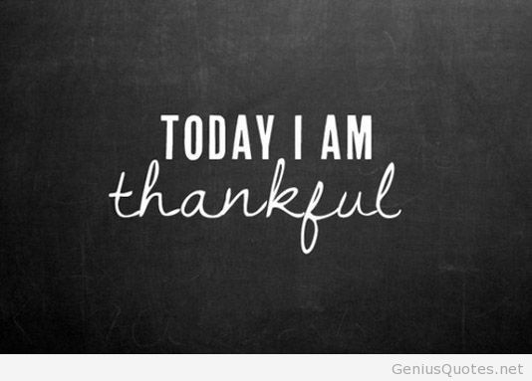
Talk to a partner about one thing from today you’re thankful for.

Slide 18
An Experiment in Gratitude
Close your eyes and think of someone who has been really influential in your life - someone who has done something really important or amazing for you.
Write down as much as you can about why that person is important to you.

Slide 19
An Experiment in Gratitude - Video (Note on Language: Bleeped out Expletive at 5:25)
Notes:
Video Link: https://www.youtube.com/watch?v=oHv6vTKD6lg

Slide 20
An Experiment in Gratitude
Your turn!
If possible, call the person you wrote about and read them your letter.
If not possible, try to figure out a way to get in contact with that person whether it’s over e-mail, social media, or snail mail.

Slide 21
Follow Up Questions
What did you learn from this activity?
How did you feel after contacting that important person in your life?
How do you think they felt?
Do you agree that gratitude is a key to happiness? Why or why not?

Slide 22
Relate Gratitude and Perspective! Some people grumble that roses have thorns, I am grateful that thorns have roses.
Alphonse Karr

Slide 23
Kid President’s 25 Reasons to be Thankful!
Notes:
Video Link: https://www.youtube.com/watch?v=yA5Qpt1JRE4

Slide 24
Your Gratitude Collage
Create your own list of 25 things you are grateful for!
Create a visual to represent the items on your list.

Slide 25
When you practice gratefulness, there is a sense of respect toward others.
Dalai Lama

Slide 26
School Community Gratitude
Create thank you cards to people in the school community, e.g., current teachers, janitors, food staff, school administration, former teachers.
Before leaving school today, be sure to deliver your gratitude letters. It’s a perfect gift before Thanksgiving.

Slide 27
Reflect

Slide 28
Talk with a Neighbor
What have you learned about gratitude?
Why is it important to show you are thankful for other people or certain things in your life?
How can you show gratitude every day?

Slide 29
Create an Action Plan!
How are you going to continue an attitude of gratitude past Thanksgiving?
Gratitude Journal
Regular thank you letters
Commit to it and think about the difference you are making in your life and those lives around you!

