Slide 1
Humility/ Modesty

Slide 2
Understand

Slide 3
Humility/ Modesty
What does humility or modesty mean to you?

Slide 4
Fairness
Fairness means to…
Play by the rules
Take turns and share
Be open-minded; listen to others
Don’t take advantage of others
Don’t blame others carelessly
Treat all people fairly

Slide 5
How to Stay Humble - Video
Notes:
Video Link: https://www.youtube.com/watch?v=TjizZbkNTew

Slide 6
Questions for the Class
What did you learn from the video about humility?
Why is it important to stay humble?
How can you avoid letting compliments fuel your ego?
What does it mean to give a compliment when you get one?
This video was geared mostly towards musicians and artists. Talk about how you can apply the advice here to something else in your life.

Slide 7
Humility is so shy. If you begin talking about it, it leaves.
Timothy Keller

Slide 8
Houses into Homes - Video
Notes:
Video Link: https://www.youtube.com/watch?v=b-zFe1cYt-I

Slide 9
Questions for the Class
What did you learn from this video about humility?
What sorts of volunteering have you done in your life?
How does it make you feel to help those less fortunate than you?
Why do you think it’s important to volunteer?
How can volunteering keep you humble?

Slide 10
Engage

Slide 11
Humility and Modesty
What does it mean to be humble or modest?
Where did this trait rank on your character strengths?
How do you demonstrate humility and modesty in your daily life?

Slide 12
Fairness
Fairness means to…
Play by the rules
Take turns and share
Be open-minded; listen to others
Don’t take advantage of others
Don’t blame others carelessly
Treat all people fairly

Slide 13
Challenge!
Starting now, try not to talk about yourself for an entire day.
“Other-mindedness” If you talk, make sure it’s focused on others.
Reflect on how many times you want to talk about yourself.

Slide 14
Challenge Reflection Questions
Were you able to complete the challenge of not talking about yourself for an entire day?
Did you find this easy or difficult? Why?
What did you learn from this challenge?

Slide 15
Humility is not thinking less of yourself, it’s thinking of yourself less.
C.S. Lewis

Slide 16
Role Play Activity!
With a partner, decide who is going to be humble and who is going to brag or be a show-off.
You can switch on and off or take turns as needed.
Use the following scenarios to role play what the situation would be like if you’re humble versus if you are not.

Slide 17
You get an A on a test

Slide 18
You receive a really awesome birthday present

Slide 19
You score the winning goal or basket for a championship game

Slide 20
Your Instagram post received more likes than ever before

Slide 21
You won first place in a contest

Slide 22
Follow Up Questions
What did you learn from this activity?
What different types of situations are harder for you to be humble in?
When role playing the humble response, did you find it difficult or easy?
What about the bragging response?
How did it make you feel to be on the receiving end of either the humble response or the bragging response?

Slide 23
Being humble means recognizing that we are not on Earth to see how important we can become, but to see how much difference we can make in the lives of others.
Gordon B. Hinckley

Slide 24
Secret Helper Activity
Think of a friend or someone in the school that needs some help or some cheering up.
Do something to help them (clean up the floor, put a nice note in their locker, organize an untidy part of the classroom, etc.)
Don’t tell anyone. Keep it a secret. Let your actions speak for you!

Slide 25
Talk with a partner!
What did you learn from this activity?
Was it difficult to keep what you did a secret? Why or why not?
How do you think things would’ve been different if you told everyone what you did?

Slide 26
Reflect

Slide 27
I can do things you cannot, you can do things I cannot; together we can do great things.
Mother Teresa

Slide 28
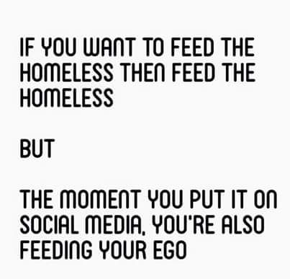
How does this represent what you’ve learned about being humble?

Slide 29
Reflect and Discuss
What have you learned about humility?
Why is it important to stay humble?
How can you work to remain humble every day?

