Slide 1
Bravery

Slide 2
Understand

Slide 3
Bravery
Describe what it means to be brave.

Slide 4
Fairness
Fairness means to…
Play by the rules
Take turns and share
Be open-minded; listen to others
Don’t take advantage of others
Don’t blame others carelessly
Treat all people fairly

Slide 5
Mental Bravery: Overcoming Fear of Water
Notes:
https://www.youtube.com/watch?v=TgKGizGLxoA

Slide 6
Questions for the Class
Why was Attis afraid of water?
How did he overcome his fear?
Did other people help?
Do you think overcoming his fear of water will give him more confidence in the future?

Slide 7
Moral Bravery: Soldier Defends Worker
Notes:
https://www.youtube.com/watch?v=bG6omxJJrw4

Slide 8
Questions for the class
How did the soldier show bravery?
Why is bravery important in social situations?
Have you seen this type of bravery in your own life?

Slide 9
Physical Bravery: Medal of Honor Recipient CPT William Swenson
Notes:
https://www.youtube.com/watch?v=JZZjw-a3taI

Slide 10
Questions for the class
How did Captain Swenson demonstrate bravery?
How did the helicopter medical evacuation (MEDIVAC) crew demonstrate bravery?
Did Captain Swenson demonstrate any other character strengths?
Did those other character strengths make him more brave?

Slide 11
Who is the bravest person you personally know?

Slide 12
Engage

Slide 13
Sara Bareilles - Brave
Notes:
https://www.youtube.com/watch?v=xwTr_CRw3GY

Slide 14
Why write “Brave”?
Brainstorm possible inspirations that might have led Sara Bareilles to write “Brave.”
What might “Brave” inspire listeners to do?

Slide 15
Heroes Hall of Fame
Fold a piece of plain white sheet paper into 4 sections. You will use this paper this week as your hall of fame for brave heroes that we learn about together. After hearing each hero’s story, write a short summary of who they were and how they exemplified bravery.

Slide 16
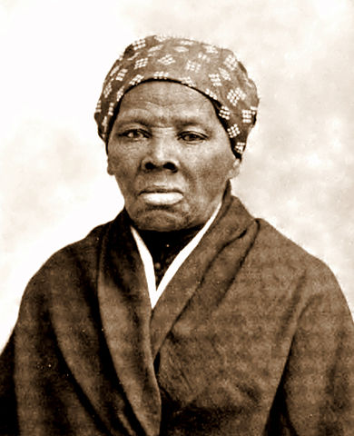
Hero # 1: Harriet Tubman
Click here
to learn about the brave life
of Harriet Tubman.
Notes:
https://www.voanews.com/a/museum-highlights-harriet-tubman-bravery-toughness-battling-slavery/3206764.html

Slide 17
Heroes Hall of Fame Entry # 1
On one of the 4 sections of your paper,
write a short summary detailing the life of
Harriet Tubman and how she exemplified bravery.

Slide 18
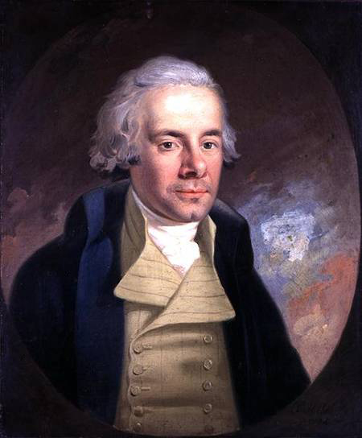
Hero # 2: William Wilberforce

Slide 19
William Wilberforce
He had the courage to dream and not let his current circumstances dictate his future.
His ultimate goal was to end the slave trade in Britain. As a result, he gave up a life of comfort to pursue a life of significance. He knew that his crusade to end the slave trade would be wildly unpopular, but this reality did not deter him. Even in the midst of physical beatings, assassination threats, and public slander, Wilberforce stayed focused on living out his values and fulfilling his purpose.

Slide 20
William Wilberforce
He had the courage to take decisive and intentional action.
Wilberforce did not just talk about ending the slave trade, he took direct action to end it. He used his position and influence to introduce bills in Parliament time and time again throughout the 1790’s, even though they did not pass. And although he was not seeing the results he desired, Wilberforce was disciplined enough to act with conviction and continue pursuing his goals.

Slide 21
William Wilberforce
He had the courage to persevere in the midst of adversity.
Wilberforce never gave up on his dream. He stayed the course. He put forth legislative bills. He influenced public opinion about the evils of slavery. He made the case for abolition. Finally in 1807, his 20-year labor paid off, as the House of Commons in Britain voted to the end the slave trade. Wilberforce wept at the realization of his dream coming true before his very own eyes.

Slide 22
Heroes Hall of Fame Entry # 2
On one of the 4 sections of your paper, write a short summary detailing the life of William Wilberforce and how he exemplified bravery.

Slide 23
Hero # 3: D-Day Veterans
Watch as Tom Rice, a paratrooper and D-Day veteran shares his story.
Notes:
https://www.youtube.com/watch?v=wDLrZ2BpbQo

Slide 24
Heroes Hall of Fame Entry # 3
On one of the 4 sections of your paper, write a short summary detailing the story of D-Day and how D-Day veterans exemplified bravery.

Slide 25
Heroes Hall of Fame Entry # 4
On your last section of paper, write a short summary detailing the life of a brave individual who lived either in the past or in the present. Explain how he/she has exemplified bravery.

Slide 26
Bravery Bucket List
Create your own bravery bucket list. Use the ideas below for inspiration! Once your bucket list is complete, make a plan to accomplish it!
Try a food that you've never tried before.
Engage in a new experience.
Do something that might be a little risky such as skateboarding or riding a bike for the first time.
Stand up for a person who is being bullied.
Stand up for yourself.
Help out a person or animal in need.
Do something by yourself for the first time.
Make a presentation about something you believe in.
Stand up against racism or prejudice.
Sign up for a program or class that intimidates you.

Slide 27
Reflect

Slide 28
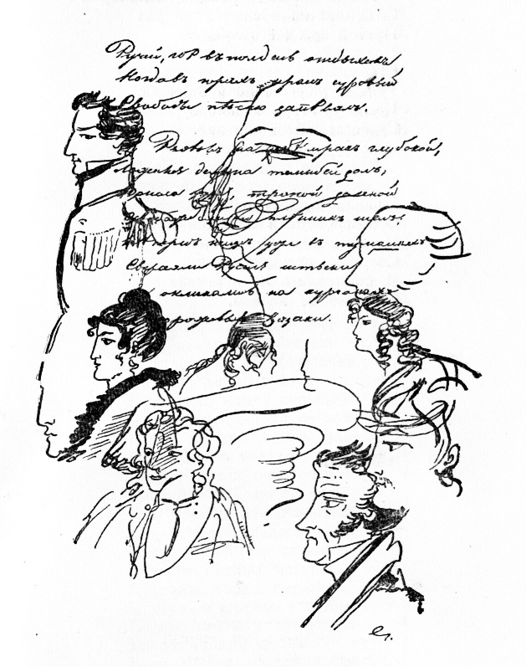
Graffiti Reflection
Using what you’ve learned this week, draw pictures or write words on a piece of paper that represent what bravery means to you. Share your art with your group.

