Slide 1
Chemistry Unit: Matter
Possible Warm Up Questions

Slide 2
Get a computer☺

Slide 3
Warm-up
Take the exit slip off of the front table.
We are going to use this as an entrance slip since we ran out of time yesterday.
Complete independently without talking.

Slide 4
Warm-up
What is matter?
How do you determine if something is made of matter or not made of matter?
Classify if the following items are made of matter or not made of matter:
Water, Air, Light, Electricity, Rocks, Humans

Slide 5
Day Two
What is the most basic form of matter?
What do you call the center of an atom?
What can you find in an atom’s nucleus?
Protons have a _________ charge and neutrons have a ______ charge.
What are the particles called that orbit the nucleus?
What kind of charge do electrons have?

Slide 6
Classify each of the following as an element [E], a compound [C], or a mixture [M].
TURN IN YOUR PROJECT AT THE COUNTER LABELED FOR
YOUR CLASS PERIOD.
Air
Carbon dioxide
Silver
Ice
Gold
Water
Seawater
Sugar
A chocolate sundae
A Big Mac®

Slide 7
Example: Something to follow Thorium + Protactinium
1. You’ll want to be first!
Cerium + Radium
2. Masked bandit
Nitrogen + Cobalt + Radium + Oxygen
3. Not anybody
Oxygen + Boron + Dysprosium + Nitrogen + Oxygen
4. Beware of this snake!
Oxygen + Carbon + Boron + Radium

Slide 8
Day Four
1. You’ll want to be first!
Cerium + Radium
2. Masked bandit
Nitrogen + Cobalt + Radium + Oxygen
3. Not anybody
Oxygen + Boron + Dysprosium + Nitrogen + Oxygen
4. Beware of this snake!
Oxygen + Carbon + Boron + Radium

Slide 9
The windows of your school are made of glass. Which of the following statements describes the motion of the molecules that make up the glass?
A. The molecules of the glass are never moving.
B. The molecules of the glass are always moving.
C. The molecules of the glass move only when the sun warms the window.
D. The molecules of the glass move only when the window is being opened or closed.
Which is the best answer? Please explain why that is the best answer and/or why you selected that answer.

Slide 10
Warm-up
What is the most important thing you learned while creating your project?
Pick-up a study guide from the front table.

Slide 11
Day Six
Which of the following is a characteristic property of a pure substance?
A. How much of the substance dissolves in water
B. How much space the substance takes up
C. What the temperature of the substance is
D. What the width of the substance is
Which is the best answer? Please explain why that is the best answer and/or why you selected that answer.
Notes:
A. All the other options are dependent on the amount of matter present.

Slide 12
Warm-up
Directions 1-4: Match the scientist to their contribution.
____________ 1. Thompson A. First theorist to come up with the idea that all object are made up of atoms.
____________ 2. Rutherford B. Plum pudding model and cathode ray. Came up with idea of electrons.
____________ 3. Democritus C. Stated that all substances are made of atoms.
____________ 4. Dalton D. Planetary Model of an atom. Nucleus and protons in the middle, electrons revolve around.
Notes:
Thompson B, Rutherford D, Democritus A, Dalton

Slide 13
1.What is the atomic number for Chlorine?
2.What is the atomic mass for Boron?
3.How many protons are in one atom of Na?
4. How many neutrons are in one atom of Helium?
5. How many electrons in one atom of Cl?

Slide 14
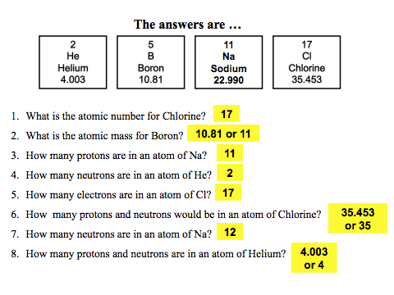

Slide 15
Candy Atoms Warm-up
Take out your periodic table and pick up the Candy atoms instruction sheet from the front table. Read the instructions for today.
Choose an element from the periodic table with an atomic # between 3 and 8 (Lithium-Oxygen).
In your notebook draw the atomic structure to include protons, neutrons, and electrons. You can not build an atom until Ms. Zeches approves your drawing.

Slide 16
Day Nine
INSTRUCTIONS: Identify if the material is heterogeneous or if it is homogeneous.
1. Wood 6. Dirt
2. Freshly-brewed black coffee 7. Sausage-and-mushroom pizza
3. Water 8. Air
4. Lucky Charms 9. Milk
5. Salt 10. Salt

Slide 17
Day Ten
Describe the similarities and differences between a mixture, solution, and colloid.

