Slide 1
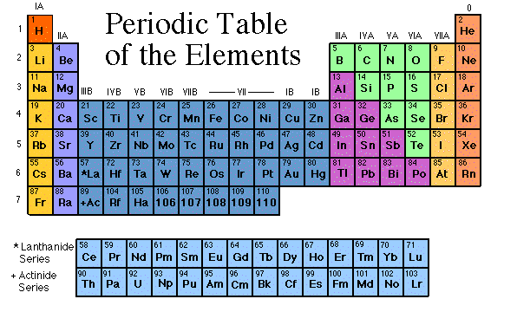
Families on the Periodic Table
Elements on the periodic table can be grouped into families bases on their chemical properties.
Each family has a specific name to differentiate it from the other families in the periodic table.
Elements in each family
react differently with
other elements.
some images are from www.chem4kids.com
www.middleschoolscience.com 2008

Slide 2
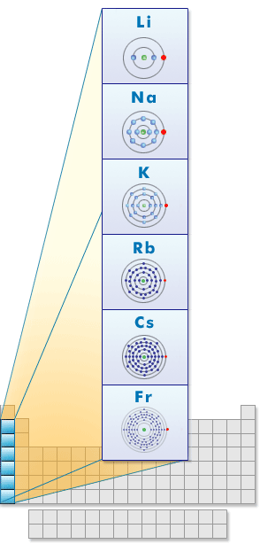
ALKALI METALS
Group 1
Hydrogen is not a member, it is a non-metal
1 electron in the outer shell
Soft and silvery metals
Very reactive, esp. with water
Conduct electricity
Image: http://www.learner.org/interactives/periodic/groups2.html

Slide 3
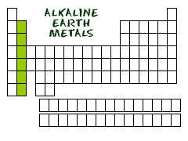
ALKALINE EARTH METALS
Group 2
2 electrons in the outer shell
White and malleable
Reactive, but less than Alkali metals
Conduct electricity

Slide 4
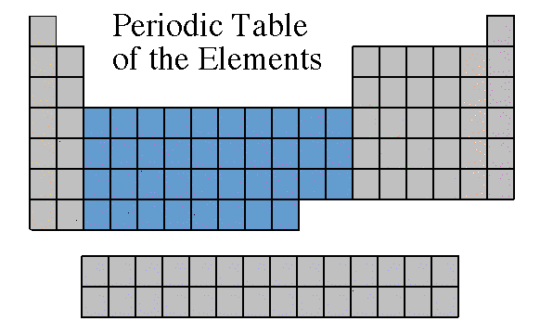
TRANSITION METALS
Groups in the middle
Good conductors of heat and electricity.
Some are used for jewelry.
The transition metals are able to put up to 32 electrons in their second to last shell.
Can bond with many elements in a variety of shapes.

Slide 5
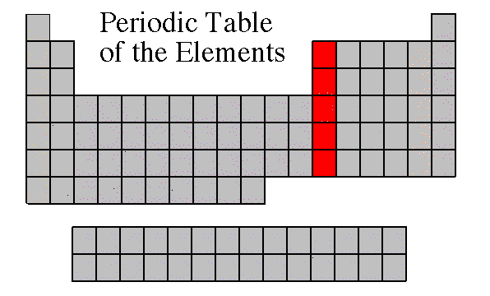
BORON FAMILY
Group 13
3 electrons in the outer shell
Most are metals
Boron is a metalloid

Slide 6
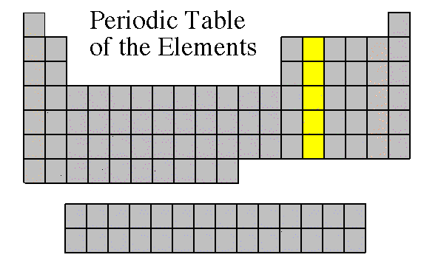
CARBON FAMILY
Group 14
4 electrons in the outer shell
Contains metals, metalloids, and a non-metal Carbon (C)

Slide 7
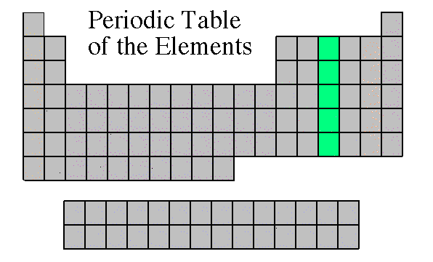
NITROGEN FAMILY
Group 15
5 electrons in the outer shell
Can share electrons to form compounds
Contains metals, metalloids, and non-metals

Slide 8
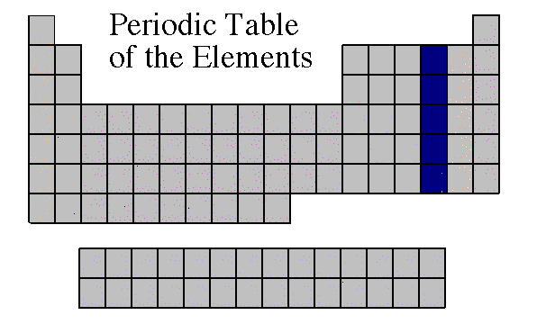
OXYGEN FAMILY
Group 16
6 electrons in the outer shell
Contains metals, metalloids, and non-metals
Reactive

Slide 9
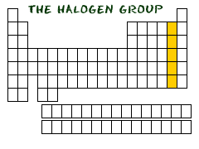
Halogens
Group 17
7 electrons in the outer shell
All are non-metals
Very reactive are often bonded with elements from Group 1

Slide 10
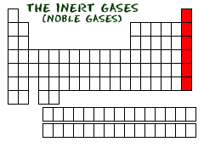
Noble Gases
Group 8
Exist as gases
Non-metals
8 electrons in the outer shell = Full
Helium (He) has only 2 electrons in the outer shell = Full
Not reactive with other elements

Slide 11
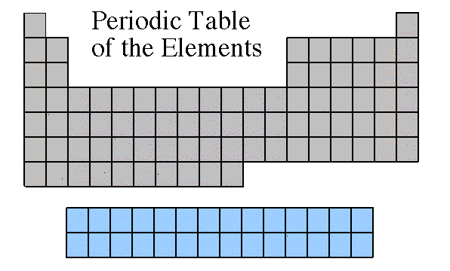
Rare Earth Metals (Lanthanides and Actinides)
Some are Radioactive
The rare earths are silver, silvery-white, or gray metals.
Conduct electricity

